Slide 1
Neural networks - Examples
Natural Language Processing

Slide 2
Example 1
4 inputs
1 hidden layer with 5 neurons and ReLU activation function
Output layer with 2 neurons with softmax activation function

Slide 3
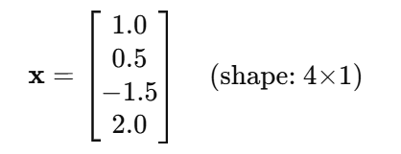
Example 1
Input Vector
Let’s assume a single input sample:

Slide 4
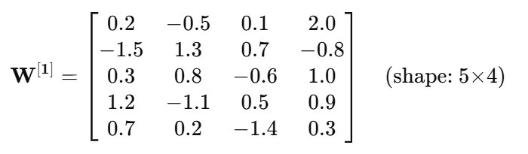
Example 1
Weights and Biases
Weights from Input to Hidden Layer:
Let’s define the weight matrix:

Slide 5
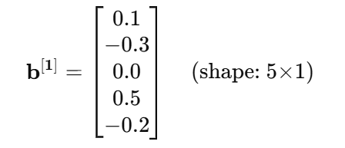
Example 1
Bias vector:

Slide 6


Example 1
Weights from Hidden to Output Layer:
Bias vector:

Slide 7
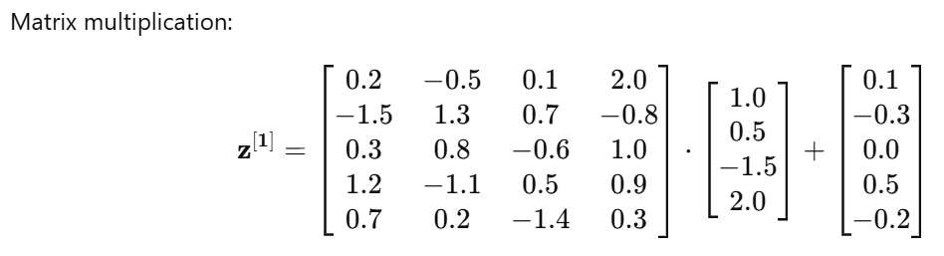

Example 1
Hidden Layer Calculation
Step 1: Linear Transformation
$z^{\left[1\right]}=W^{\left[1\right]}⋅x+b^{\left[1\right]}$

Slide 8
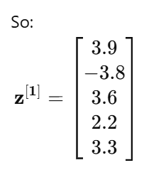
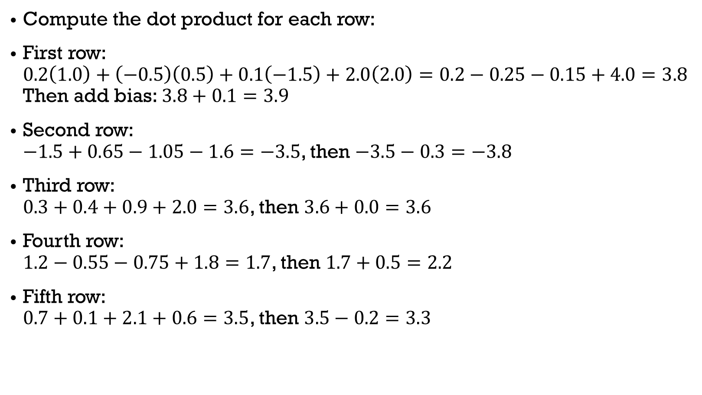
Example 1
Compute the dot product for each row:
First row: $0.2\left(1.0\right)+\left(−0.5\right)\left(0.5\right)+0.1\left(−1.5\right)+2.0\left(2.0\right)=0.2−0.25−0.15+4.0=3.8$ Then add bias: $3.8+0.1=3.9$
Second row: $−1.5+0.65−1.05−1.6=−3.5$, then $−3.5−0.3=−3.8$
Third row: $0.3+0.4+0.9+2.0=3.6$, then $3.6+0.0=3.6$
Fourth row: $1.2−0.55−0.75+1.8=1.7$, then $1.7+0.5=2.2$
Fifth row: $0.7+0.1+2.1+0.6=3.5$, then $3.5−0.2=3.3$

Slide 9
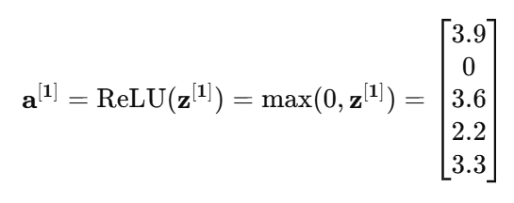
Example 1
Step 2: ReLU Activation
Apply ReLU:

Slide 10
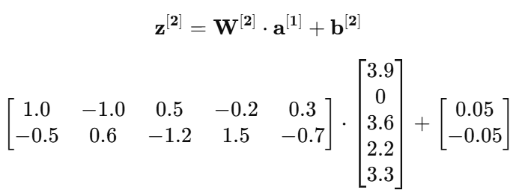
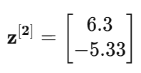

Example 1
Output Layer Calculation
Step 1: Linear Transformation
$z^{\left[2\right]}=W^{\left[2\right]}⋅a^{\left[1\right]}+b^{\left[2\right]}$
First row:
$1.0\left(3.9\right)+\left(−1.0\right)\left(0\right)+0.5\left(3.6\right)+\left(−0.2\right)\left(2.2\right)+0.3\left(3.3\right)=3.9+0+1.8−0.44+0.99=6.25, 6.25+0.05=6.3$
Second row:
$−0.5\left(3.9\right)+0.6\left(0\right)+\left(−1.2\right)\left(3.6\right)+1.5\left(2.2\right)+\left(−0.7\right)\left(3.3\right)=−1.95+0−4.32+3.3−2.31=−5.28, −5.28−0.05=−5.33$

Slide 11
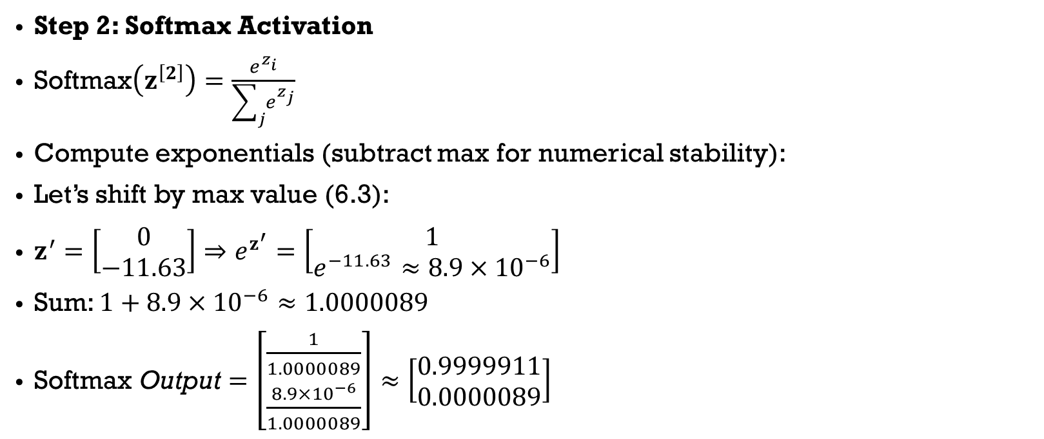
Example 1
Step 2: Softmax Activation
$\text{Softmax}\left(z^{\left[2\right]}\right)=\frac{e^{z_{i}}}{\sum_{j}{e^{z_{j}}}}$
Compute exponentials (subtract max for numerical stability):
Let’s shift by max value (6.3):
$z^{′}=\left[\begin{matrix}0 \\ −11.63\end{matrix}\right]⇒e^{z^{′}}=\left[\begin{matrix}1 \\ e^{−11.63}≈8.9×{10}^{−6}\end{matrix}\right]$
Sum: $1+8.9×{10}^{−6}≈1.0000089$
$\text{Softmax} \text{Output}=\left[\begin{matrix}\frac{1}{1.0000089} \\ \frac{8.9×{10}^{−6}}{1.0000089}\end{matrix}\right]≈\left[\begin{matrix}0.9999911 \\ 0.0000089\end{matrix}\right]$

Slide 12

Example 1
Output of the Network
$a^{\left[2\right]}=\left[\begin{matrix}0.9999911 \\ 0.0000089\end{matrix}\right]$
This means the network is highly confident in class 1 (assuming class indices start from 1).

Slide 13
Example 2
4 inputs with embedding size 3
1 hidden layer with 5 neurons and ReLU activation function
Output layer with 2 neurons with softmax activation function

Slide 14

Example 2
Input matrix (before flattening):
$X=\left[\begin{matrix}1 & 2 & 3 \\ 4 & 5 & 6 \\ 7 & 8 & 9 \\ 1 & 0 & 1\end{matrix}\right]$
Flattened input vector $x∈ℝ^{12}$:
$x=\left[\begin{matrix}1 & 2 & 3 & 4 & 5 & 6 & 7 & 8 & 9 & 1 & 0 & 1\end{matrix}\right]$

Slide 15
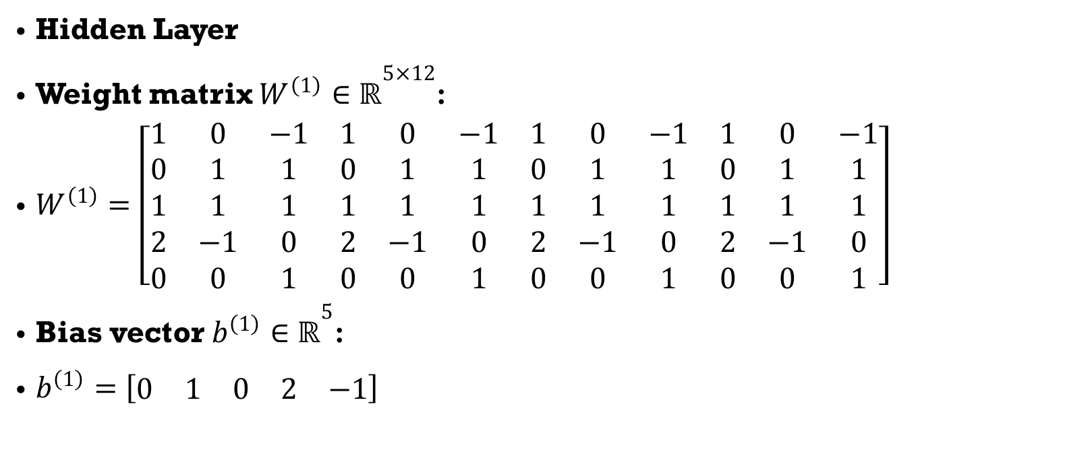
Example 2
Hidden Layer
Weight matrix $W^{\left(1\right)}∈ℝ^{5×12}$:
$W^{\left(1\right)}=\left[\begin{matrix}1 & 0 & −1 & 1 & 0 & −1 & 1 & 0 & −1 & 1 & 0 & −1 \\ 0 & 1 & 1 & 0 & 1 & 1 & 0 & 1 & 1 & 0 & 1 & 1 \\ 1 & 1 & 1 & 1 & 1 & 1 & 1 & 1 & 1 & 1 & 1 & 1 \\ 2 & −1 & 0 & 2 & −1 & 0 & 2 & −1 & 0 & 2 & −1 & 0 \\ 0 & 0 & 1 & 0 & 0 & 1 & 0 & 0 & 1 & 0 & 0 & 1\end{matrix}\right]$
Bias vector $b^{\left(1\right)}∈ℝ^{5}$:
$b^{\left(1\right)}=\left[\begin{matrix}0 & 1 & 0 & 2 & −1\end{matrix}\right]$

Slide 16

Example 2
Linear transformation at hidden layer
We compute:
$z^{\left(1\right)}=W^{\left(1\right)}⋅x+b^{\left(1\right)}$

Slide 17
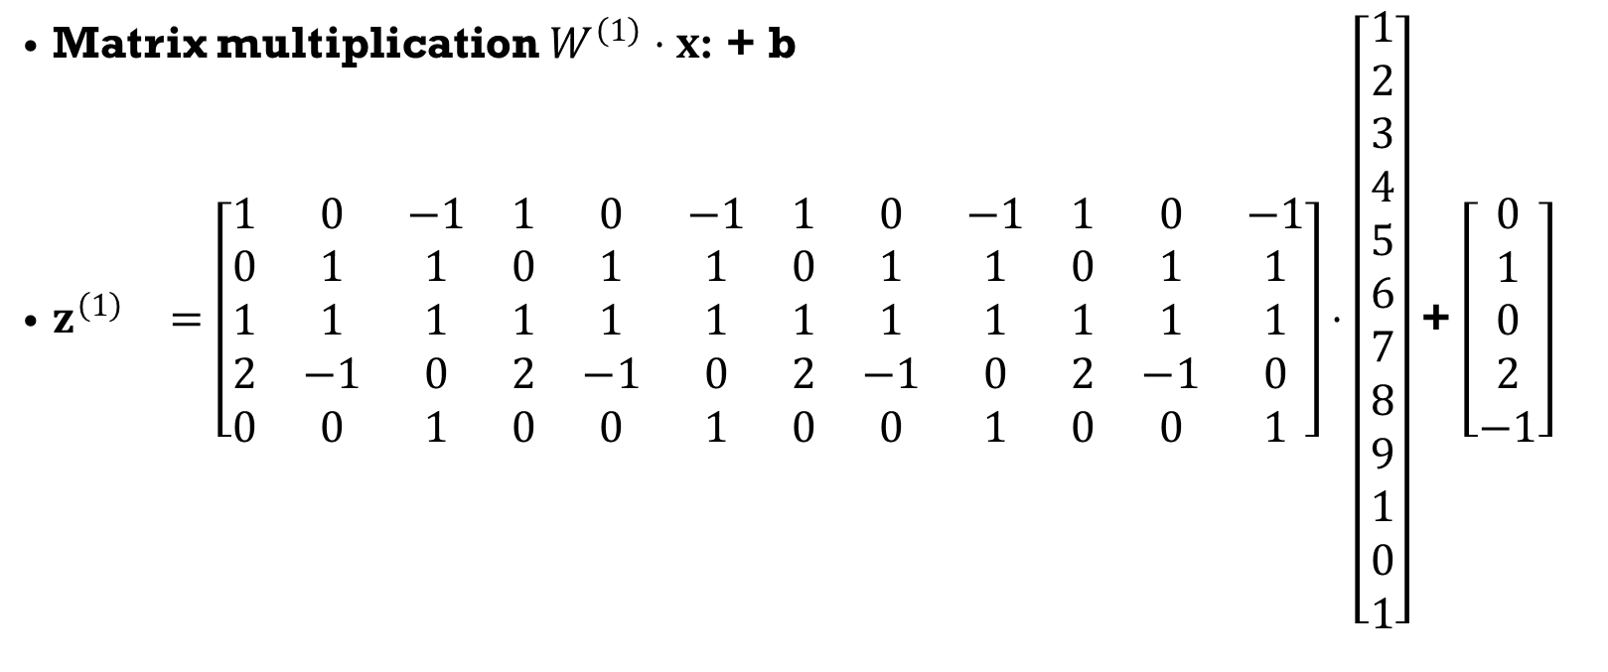
Example 2
Matrix multiplication $W^{\left(1\right)}⋅x$: + b
$\begin{matrix}z^{\left(1\right)} & =\left[\begin{matrix}1 & 0 & −1 & 1 & 0 & −1 & 1 & 0 & −1 & 1 & 0 & −1 \\ 0 & 1 & 1 & 0 & 1 & 1 & 0 & 1 & 1 & 0 & 1 & 1 \\ 1 & 1 & 1 & 1 & 1 & 1 & 1 & 1 & 1 & 1 & 1 & 1 \\ 2 & −1 & 0 & 2 & −1 & 0 & 2 & −1 & 0 & 2 & −1 & 0 \\ 0 & 0 & 1 & 0 & 0 & 1 & 0 & 0 & 1 & 0 & 0 & 1\end{matrix}\right]⋅\left[\begin{matrix}1 \\ 2 \\ 3 \\ 4 \\ 5 \\ 6 \\ 7 \\ 8 \\ 9 \\ 1 \\ 0 \\ 1\end{matrix}\right]\end{matrix}$+ $\left[\begin{matrix}0 \\ 1 \\ 0 \\ 2 \\ −1\end{matrix}\right]$

Slide 18
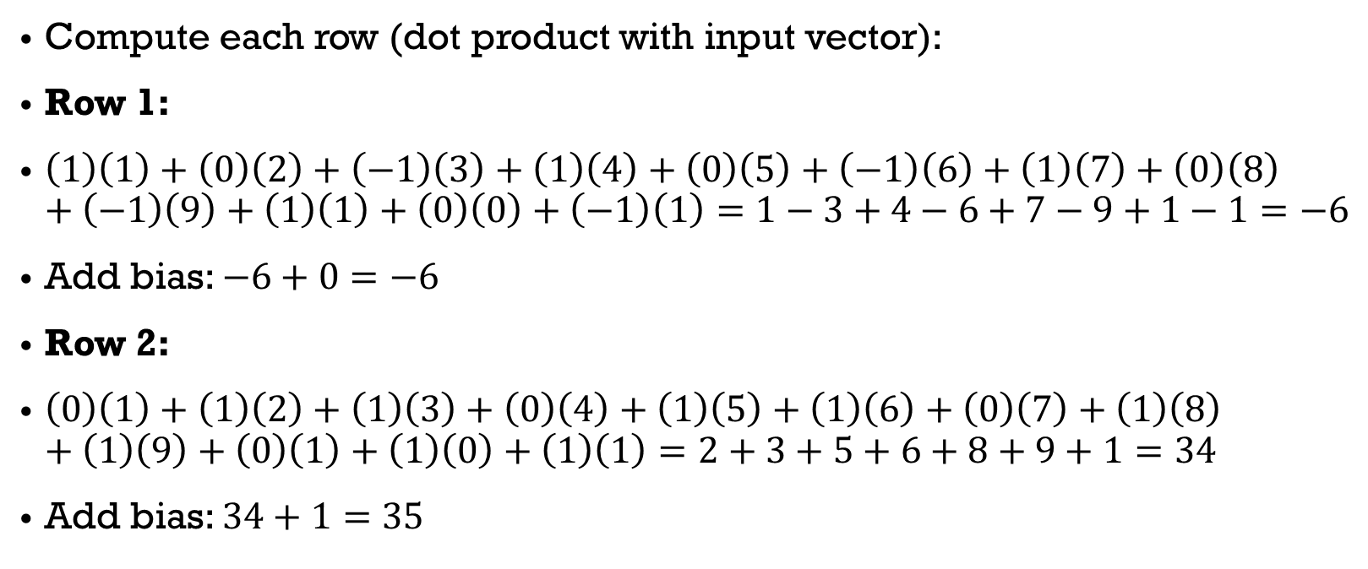
Example 2
Compute each row (dot product with input vector):
Row 1:
$\left(1\right)\left(1\right)+\left(0\right)\left(2\right)+\left(−1\right)\left(3\right)+\left(1\right)\left(4\right)+\left(0\right)\left(5\right)+\left(−1\right)\left(6\right)+\left(1\right)\left(7\right)+\left(0\right)\left(8\right)+\left(−1\right)\left(9\right)+\left(1\right)\left(1\right)+\left(0\right)\left(0\right)+\left(−1\right)\left(1\right)=1−3+4−6+7−9+1−1=−6$
Add bias: $−6+0=−6$
Row 2:
$\left(0\right)\left(1\right)+\left(1\right)\left(2\right)+\left(1\right)\left(3\right)+\left(0\right)\left(4\right)+\left(1\right)\left(5\right)+\left(1\right)\left(6\right)+\left(0\right)\left(7\right)+\left(1\right)\left(8\right)+\left(1\right)\left(9\right)+\left(0\right)\left(1\right)+\left(1\right)\left(0\right)+\left(1\right)\left(1\right)=2+3+5+6+8+9+1=34$
Add bias: $34+1=35$

Slide 19
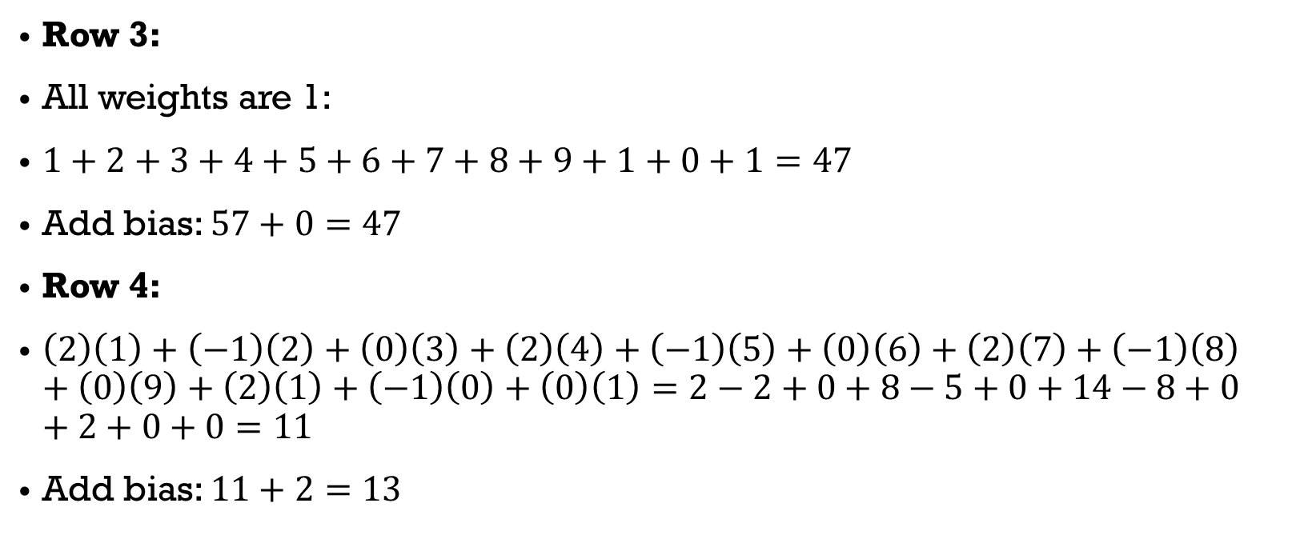
Example 2
Row 3:
All weights are 1:
$1+2+3+4+5+6+7+8+9+1+0+1=47$
Add bias: $57+0=47$
Row 4:
$\left(2\right)\left(1\right)+\left(−1\right)\left(2\right)+\left(0\right)\left(3\right)+\left(2\right)\left(4\right)+\left(−1\right)\left(5\right)+\left(0\right)\left(6\right)+\left(2\right)\left(7\right)+\left(−1\right)\left(8\right)+\left(0\right)\left(9\right)+\left(2\right)\left(1\right)+\left(−1\right)\left(0\right)+\left(0\right)\left(1\right)=2−2+0+8−5+0+14−8+0+2+0+0=11$
Add bias: $11+2=13$

Slide 20
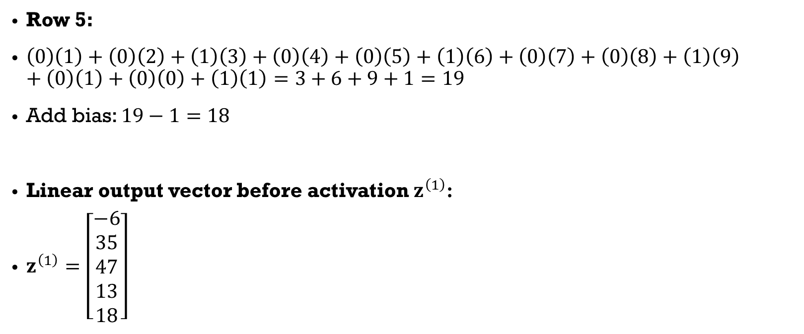
Example 2
Row 5:
$\left(0\right)\left(1\right)+\left(0\right)\left(2\right)+\left(1\right)\left(3\right)+\left(0\right)\left(4\right)+\left(0\right)\left(5\right)+\left(1\right)\left(6\right)+\left(0\right)\left(7\right)+\left(0\right)\left(8\right)+\left(1\right)\left(9\right)+\left(0\right)\left(1\right)+\left(0\right)\left(0\right)+\left(1\right)\left(1\right)=3+6+9+1=19$
Add bias: $19−1=18$
Linear output vector before activation $z^{\left(1\right)}$:
$z^{\left(1\right)}=\left[\begin{aligned}−6 \\ 35 \\ 47 \\ 13 \\ 18\end{aligned}\right]$

Slide 21

Example 2
Apply ReLU activation
a(1)=ReLU(z(1))=max(0,z(1))
$a^{\left(1\right)}=\left[\begin{aligned}0 \\ 35 \\ 47 \\ 13 \\ 18\end{aligned}\right]$

Slide 22

Example 2
Output Layer
Weight matrix $W^{\left(2\right)}∈ℝ^{2×5}$:
$W^{\left(2\right)}=\left[\begin{matrix}1 & 1 & 0 & 0 & −1 \\ −1 & 0 & 1 & 1 & 1\end{matrix}\right]$
Bias vector $b^{\left(2\right)}∈ℝ^{2}$:
$b^{\left(2\right)}=\left[\begin{aligned}0 \\ 0\end{aligned}\right]$

Slide 23
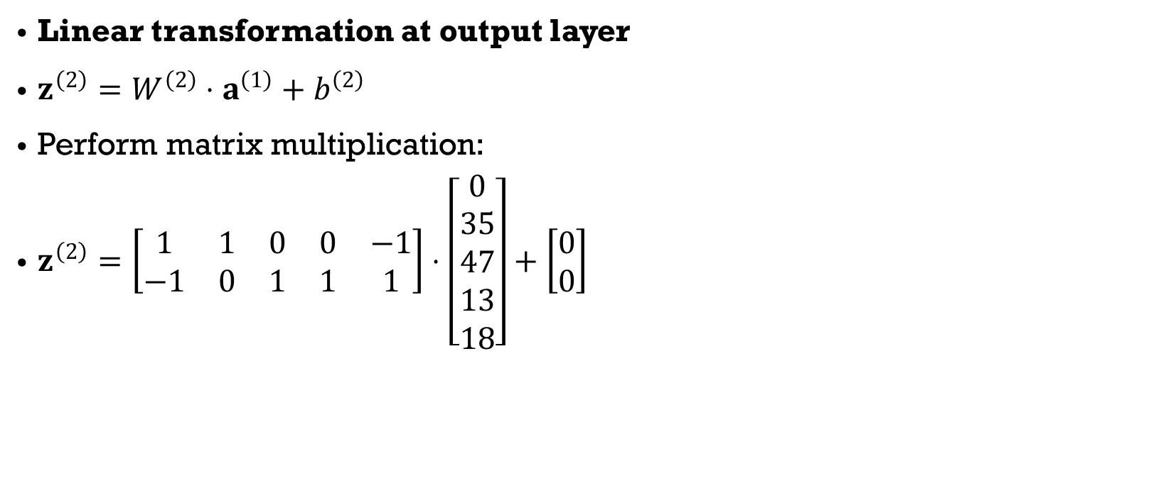
Example 2
Linear transformation at output layer
$z^{\left(2\right)}=W^{\left(2\right)}⋅a^{\left(1\right)}+b^{\left(2\right)}$
Perform matrix multiplication:
$z^{\left(2\right)}=\left[\begin{matrix}1 & 1 & 0 & 0 & −1 \\ −1 & 0 & 1 & 1 & 1\end{matrix}\right]⋅\left[\begin{matrix}0 \\ 35 \\ 47 \\ 13 \\ 18\end{matrix}\right]+\left[\begin{matrix}0 \\ 0\end{matrix}\right]$

Slide 24
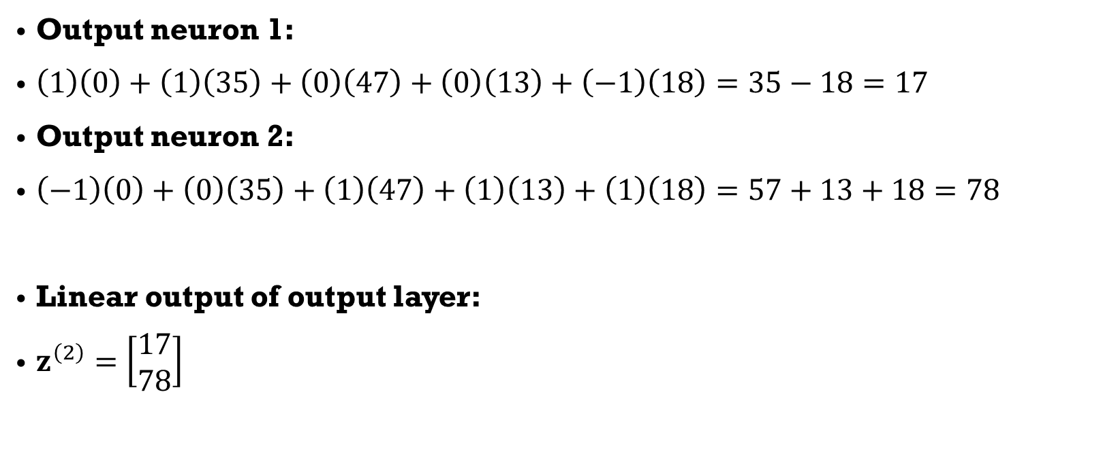
Example 2
Output neuron 1:
$\left(1\right)\left(0\right)+\left(1\right)\left(35\right)+\left(0\right)\left(47\right)+\left(0\right)\left(13\right)+\left(−1\right)\left(18\right)=35−18=17$
Output neuron 2:
$\left(−1\right)\left(0\right)+\left(0\right)\left(35\right)+\left(1\right)\left(47\right)+\left(1\right)\left(13\right)+\left(1\right)\left(18\right)=57+13+18=78$
Linear output of output layer:
$z^{\left(2\right)}=\left[\begin{aligned}17 \\ 78\end{aligned}\right]$

Slide 25

Example 2
Apply softmax
$\text{softmax}\left(z_{i}\right)=\frac{e^{z_{i}}}{\sum_{j}{e^{z_{j}}}}$
Apply numerical stability trick: subtract max (78):
$z^{\left(2\right)}−\max{=}\left[\begin{aligned}−61 \\ \begin{matrix} \\ 0\end{matrix}\end{aligned}\right]$
$\text{softmax}\left(\left[\begin{aligned}−61 \\ \begin{matrix} \\ 0\end{matrix}\end{aligned}\right]\right)=\left[\begin{aligned}\frac{e^{−61}}{e^{−61}+e^{0}} \\ \begin{matrix} \\ \frac{e^{0}}{e^{−71}+e^{0}}\end{matrix}\end{aligned}\right]≈\left[\begin{aligned}0 \\ 1\end{aligned}\right]$
Final Output of Network
$\left[\begin{aligned}0 \\ 1\end{aligned}\right]$
The network predicts class 2 (index 1) with full confidence.

Slide 26
References
https://www.youtube.com/watch?v=sNTtUV9yE_M

